Slide 1

Code Composer Studio v6
Overview

Slide 2
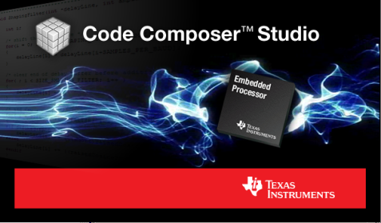
Code Composer Studio
What is Code Composer Studio?
Integrated development environment for TI’s embedded processors supporting all Microcontrollers and Processors in a single environment
A suite of tools including a debugger, compiler, editor…
Based on the Eclipse open source software framework
Eclipse is widely used by many development environments
Offers a rich set of code development tools
TI contributes changes directly to the open source community
Extended by TI to support device capabilities
Integrate additional tools & functionality
OS application development tools (TI-RTOS, Linux, Android…)
Code analysis, source control…

Slide 3
Where does CCS fit in the Ecosystem?
There is a diverse ecosystem of software and tools supporting TI embedded processors (especially ARM based devices)
CCS is a software development environment that is available for all of our embedded processor families
A selection of free CCS options allow users to get started without having to invest a significant amount of money
Support from partner tools is essential to TI success
Some of our partners provide products that offer a differentiated feature set or a feature set tailored to specific market segments
Customers are free to choose the product that best meets their needs or individual preferences
TI will make selected features available in partner environments (XDS debug probe support, Grace, ULP Advisor are examples)

Slide 4
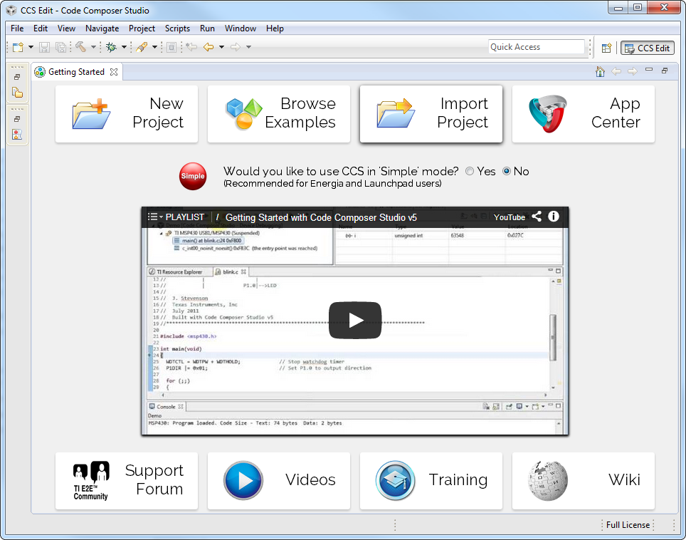
Getting Started View
Initial screen visible when Code Composer Studio is launched
Provides fast access to common tasks
Create a new project
Use a example
Open the App Center…
Embedded Getting Started Video walks users through the basics of using CCS
Links to support, videos and training material

Slide 5
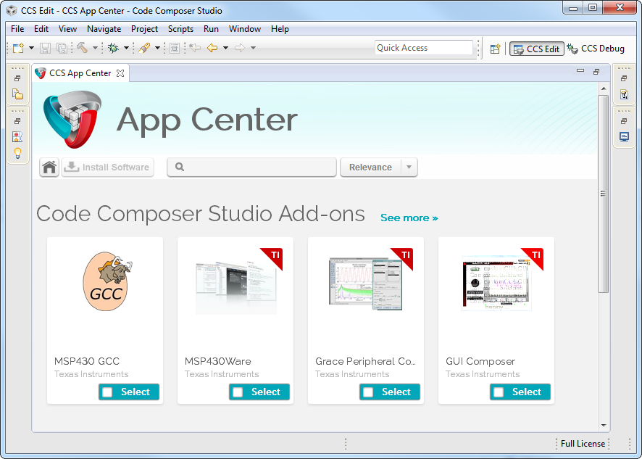
CCS App Center
Access to additional products
“Wares”
SDKs
New features
Keep products up to date from within CCS
Further reduce CCS download size
Great way to promote features

Slide 6
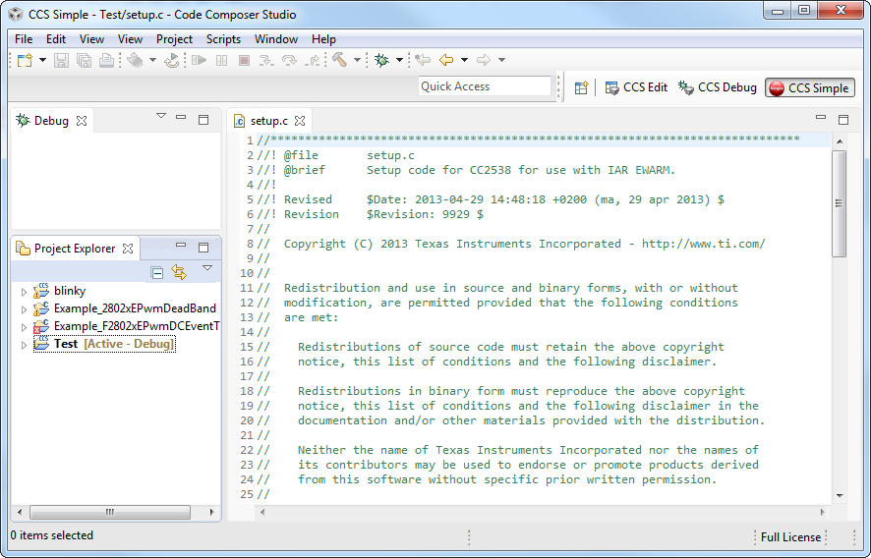
“Simple” Mode
Enabling “Simple” mode reduces the environment to just essential functionality
Makes it easier for new users, especially LaunchPad type customers to start using the CCS environment

Slide 7
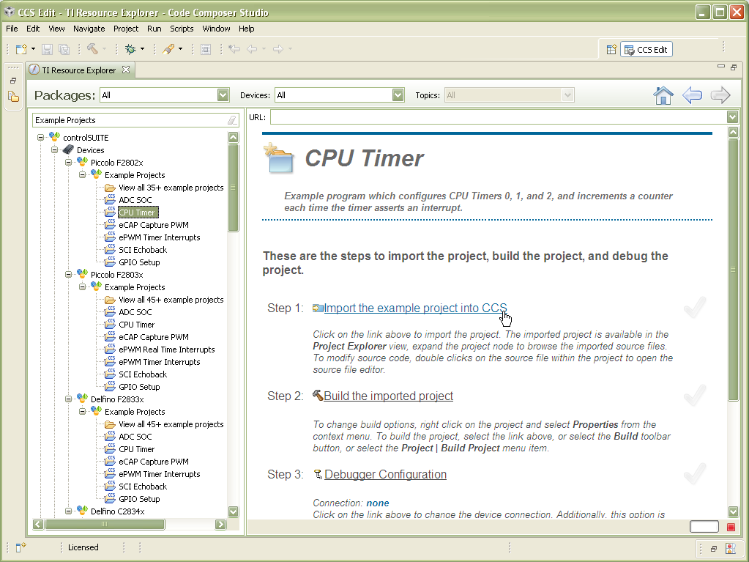
Resource Explorer
Easily access a broad selection of packages such as controlSUITE, MSP430ware, TivaWare, TI-RTOS…
Guides you step by step through using examples
Provides links to documentation, videos and other collateral

Slide 8
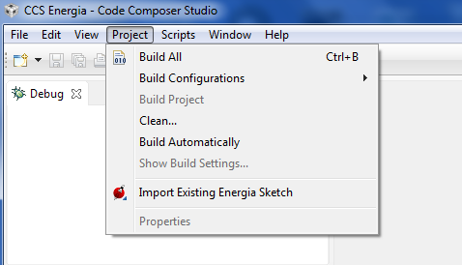
Energia Support in CCSv6
Import existing Energia sketches
Leverage existing work
You can build/edit/debug Energia projects inside CCS
Provide more debugging capabilities
JTAG debug
Register display
See the generated code
Keep it simple
CCS will most likely be customer’s second debugger ever used and their first full software development environment
Recommended to use “Simple” Mode

Slide 9
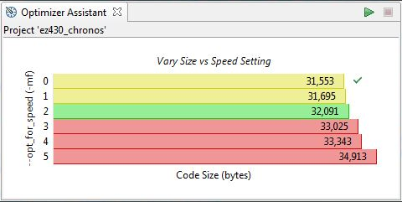
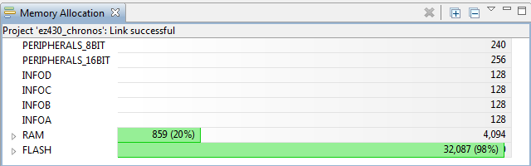
Optimizer Assistant
Provides advice on how to get the best performance for available code size.
Graphical display of memory usage.
CCS APPS

Slide 10
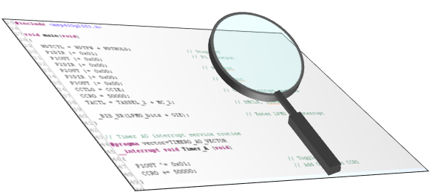
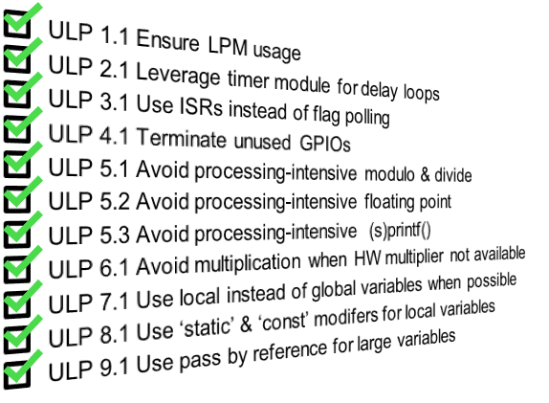
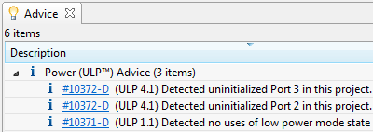
ULP (Ultra Low Power) Advisor Turning MCU developers into Ultra-Low-Power experts
ULP Advisor analyzes all C code line by line.
Checks against a thorough Ultra-Low-Power checklist.
Highlights areas of improvement within code.
Can benefit any application
Checks all code within a project at build time
Enabled by default
Parses code line-by-line
List of 15 Ultra-Low-Power best practices
Compilation of ULP tips & tricks from the well-known to the more obscure
Combines decades of Ultra-Low-power development experience
Identify key areas for improvement
Listed in the “Advice” view
Includes a link to more information
www.ti.com/ulpadvisor

Slide 11
Code Composer Studio Licenses
Free options:
90 day evaluation
MSP430: 16KB Code Size Limited with the optimizing TI compiler
MSP430: unlimited code size with GCC
When using XDS100 JTAG emulators
Tied to development kits with onboard emulation (not for MSP430)
Purchase professional tools:
Starting at $495
Node Locked License (tied to a PC)
Floating Licenses available (shared licenses)
www.ti.com/ccstudio
http://processors.wiki.ti.com/index.php/Download_CCS

Slide 12
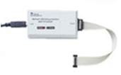

MSP430 JTAG Emulators
USB Interface
Compatible with CCS, IAR and other debuggers
$99
Parallel Port Interface
Compatible with CCS, IAR and other debuggers
$49
MSP-FET430UIF
MSP-FET430PIF

Slide 13

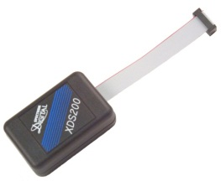
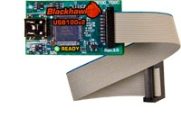
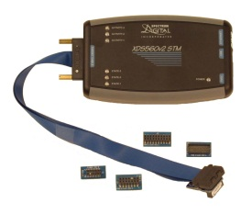
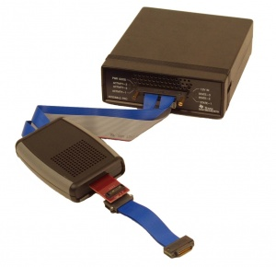
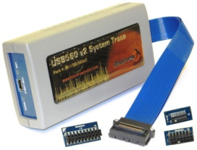
XDS Debug Probes
Entry level JTAG emulator
USB interface
3 models based on JTAG headers (14pin TI, 20pin TI, 20/10pin ARM)
$79
Excellent balance of performance and cost
USB interface (Ethernet version available)
20pin TI, 14pin TI, 20pin ARM and 10pin ARM connectors
$295
XDS100v2 – Entry Level
XDS200 – Mid Range
USB or USB + Ethernet interfaces
Includes multiple JTAG adapters (14pin TI, 20pin TI, 20pin ARM, 60pin MIPI, some include 60pin TI)
System Trace
$995 - $1495
Trace Receiver & XDS560v2 JTAG emulator
USB + Ethernet interfaces
MIPI60 and 60pin TI adapters
DSP, ARM & System Trace to pins
$3495
XDS560v2 – High Performance
Pro Trace
Notes:
Now that we have covered our JTAG solutions ranging from the entry level XDS100 all the way up to our XDS PRO TRACE receiver I am now going to hand over control to Rafael who is going to perform a brief demonstration that highlights the differences in performance between our XDS100, 200 and 560 products.

Slide 14
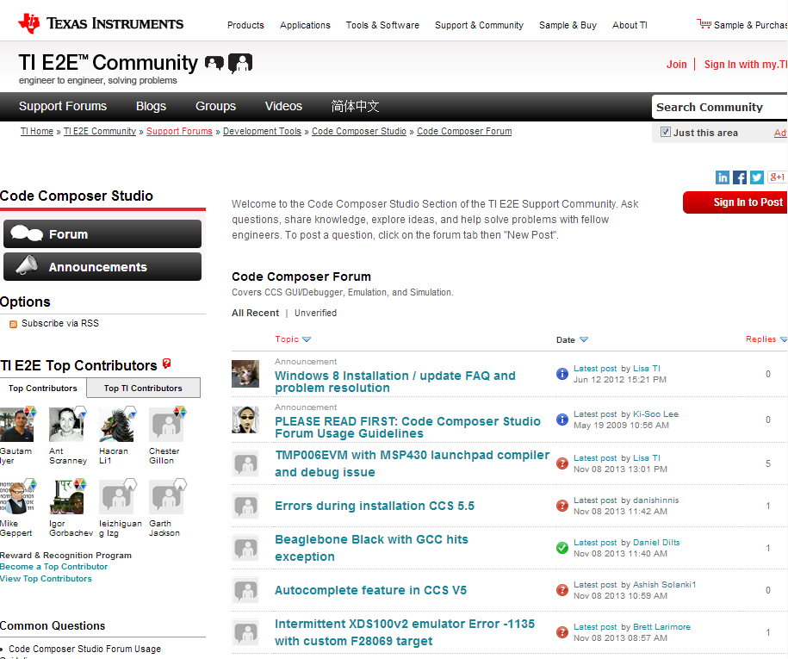
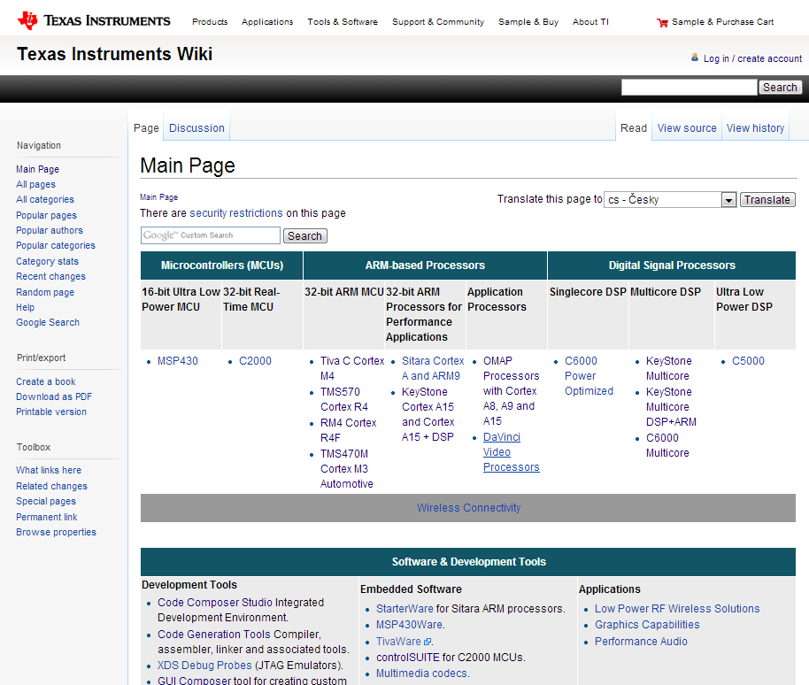
Extensive Support
E2E Community
Wiki
Videos, Blogs, Forums
Global customer support
Search for answers
http://e2e.ti.com
Technical articles
Training
Design ideas
http://processors.wiki.ti.com
Notes:
Wiki:
Same infrastructure as Wikipedia.
Wealth of technical articles
E2E Community:
Conversation oriented. You can post a question and get answers within a community. We have experts monitoring posts and answering questions.

Slide 15
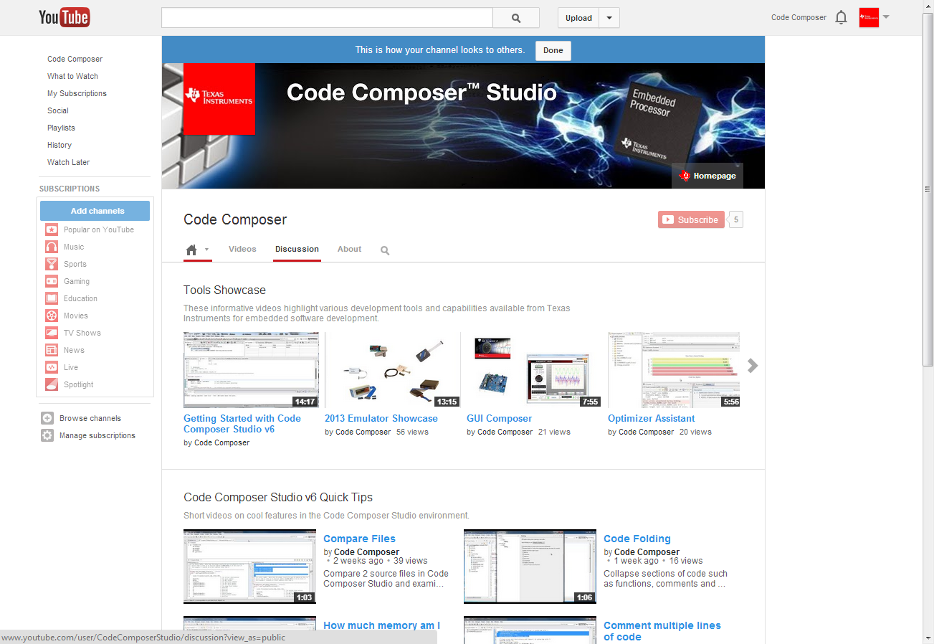
YouTube Channel

